Slide 1

Ethical and Social Issues in Information Systems
Chapter 4
Ali Bazarah
MIS 300

Slide 2
Learning Objectives
4.1 What ethical, social, and political issues are raised by information systems?
4.2 What specific principles for conduct can be used to guide ethical decisions?
4.3 Why do contemporary information systems technology and the Internet pose challenges to the protection of individual privacy and intellectual property?
4.4 How have information systems affected laws for establishing accountability, liability, and the quality of everyday life?

Slide 3
Videos
Video 1 Setting Facebook privacy controls https://www.youtube.com/watch?v=IWlyut4zsko
Video 2: Google, Privacy and What It Means For You
https://www.youtube.com/watch?v=V7M_FOhXXKM

Slide 4
What Ethical, Social, and Political Issues are Raised by Information Systems? (1 of 2)
The introduction of new information technology has a ripple effect, raising new ethical, social, and political issues
Ethics
Principles of right and wrong that individuals use to make choices to guide their behaviours

Slide 5
What Ethical, Social, and Political Issues are Raised by Information Systems? (2 of 2)
Information systems raise new ethical questions because they create opportunities for:
Intense social change, threatening existing distributions of power, money, rights, and obligations
Raise concerns about the appropriate use of customer information, the protection of personal privacy, and the protection of intellectual property.
New kinds of crime

Slide 6
A Model for Thinking About Ethical, Social, and Political Issues
I T as creating ripples of new situations not covered by old rules
Social and political institutions cannot respond overnight to these ripples—it may take years to develop etiquette, expectations, laws
Requires understanding of ethics to make choices in legally gray areas

Slide 7
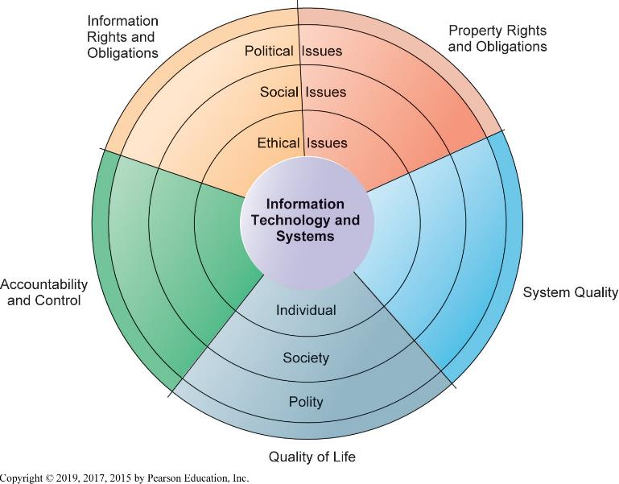
Figure 4.1 The Relationship Between Ethical, Social, and Political Issues in an Information Society
Notes:
Figure 4.1, Page 119.
The introduction of new information technology has a ripple effect, raising new ethical, social, and political issues that must be dealt with on the individual, social, and political levels. These issues have five moral dimensions: information rights and obligations, property rights and obligations, system quality, quality of life, and accountability and control.

Slide 8
Five Moral Dimensions of the Information Age
Information rights and obligations (Privacy)
Property rights and obligations (how intellectual property rights be protected in a digital society)
Accountability and control(who will be held accountable and liable for the harm done to individual )
System quality (What standards of data and system quality should we demand to protect individual rights)
Quality of life (Which cultural values and practices does the new information technology support?)

Slide 9
Key Technology Trends That Raise Ethical Issues
Computing power doubles every 18 months
Data storage costs rapidly decline
Data analysis advances
Networking advances
Mobile device growth impact

Slide 10
Advances in Data Analysis Techniques
Profiling
Combining data from multiple sources to create dossiers of detailed information on individuals
Nonobvious relationship awareness (N O R A )
Combining data from multiple sources to find obscure hidden connections that might help identify criminals or terrorists

Slide 11
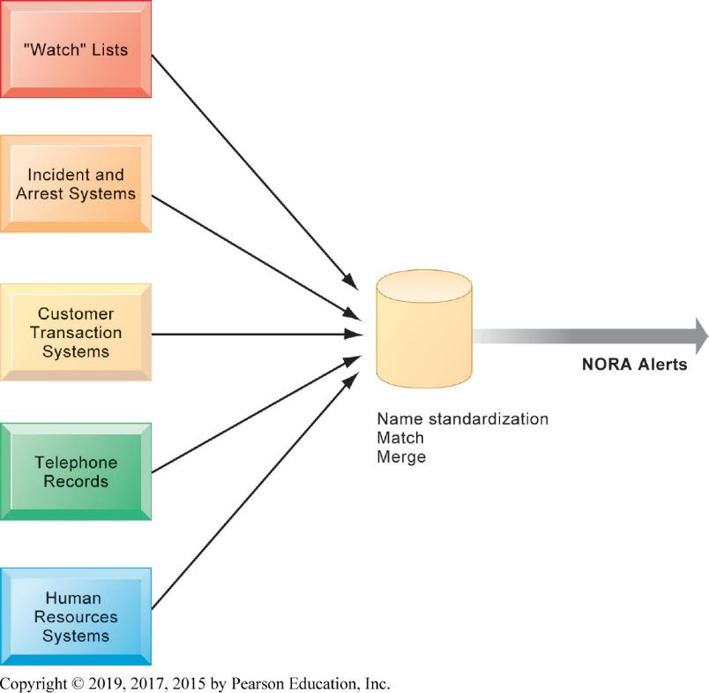
Figure 4.2 Nonobvious Relationship Awareness (N O R A )
Notes:
Figure 4.2, Page 122.
NORA technology can take information about people from disparate sources and find obscure, nonobvious relationships. It might discover, for example, that an applicant for a job at a casino shares a telephone number with a known criminal and issue an alert to the hiring manager.

Slide 12
Principles for conduct: Responsibility, Accountability, and Liability
Responsibility
Accepting the potential costs, duties, and obligations for decisions
Accountability
Mechanisms for identifying responsible parties (who took the action)
Liability
Permits individuals (and firms) to recover damages done to them by others
Due process
Laws are well-known and understood, with an ability to appeal to higher authorities
Notes:
Using information technology in a socially responsible manner means that you can and will be held accountable for the consequences of your actions.”
Explain that information systems do not exist in a vacuum and that these concepts are instrumental in understanding the impact of systems and measuring their success. Ask students why liability and due process are such important ethical concepts? (A rough answer would be that they provide recourse to individuals negatively effected by mismanagement of information systems, providing incentive to “play by the rules”.)

Slide 13
Ethical Analysis
When confronted with a situation that seems to present ethical issues, how should you analyze it?
Five-step process for ethical analysis
Identify and clearly describe the facts.
who did what to whom and where, when, and how
Define the conflict or dilemma and identify the higher-order values involved (e.g., freedom, privacy, protection of property)
Identify the stakeholders.
Identify the options that you can reasonably take.
Identify the potential consequences of your options.

Slide 14
Professional Codes of Conduct
Promulgated by associations of professionals
American Medical Association (A M A )
American Bar Association (A B A )
Association for Computing Machinery (A C M )
Promises by professions to regulate themselves in the general interest of society
Should companies be allowed to read employees’ emails, especially if they are personal? Should employees be allowed to send personal emails

Slide 15
Information Rights: Privacy and Freedom in the Internet Age
Privacy
Claim of individuals to be left alone, free from surveillance or interference from other individuals, organizations, or state.
Claim to be able to control information about yourself

Slide 16
Information Rights: Privacy and Freedom in the Internet Age
Fair information practices
Set of principles governing the collection and use of information
Basis of most U.S. and European privacy laws
Used to drive changes in privacy legislation
Child Online Privacy Protection Act C O P P A
Gramm-Leach-Bliley Act
Health Insurance Portability and Accountability Act HIPAA

Slide 17
European Directive on Data Protection
Use of data requires informed consent of customer
E U member nations cannot transfer personal data to countries without similar privacy protection
New E U General Data Protection Regulation (G D P R) replacing existing Data Protection :
Applies across all E U countries to any firms operating in E U
Strengthens right to be forgotten
gives EU citizens the right to ask Google and social network sites to remove their personal information

Slide 18
Internet Challenges to Privacy (1 of 2)
Cookies
Identify browser and track visits to site
Super cookies (Flash cookies)
Web beacons (web bugs)
Tiny graphics embedded in emails and web pages
Monitor who is reading email message or visiting site
Spyware
installed on user’s computer
May transmit user’s keystrokes or display unwanted ads
Google services and behavioral targeting

Slide 19
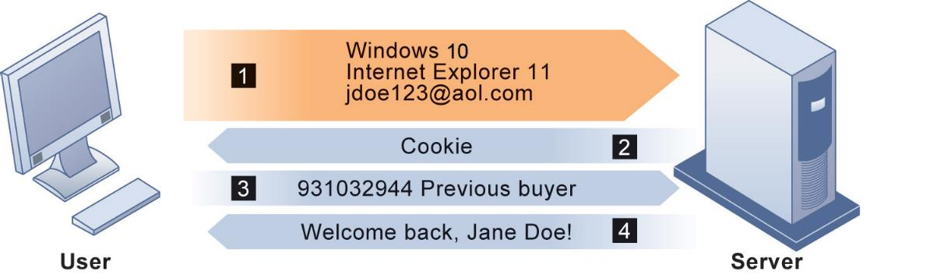
Figure 4.3 How Cookies Identify Web Visitors
The Web server reads the user's Web browser and determines the operating system, browser name, version number, Internet address, and other information.
The server transmits a tiny text file with user identification information called a cookie, which the user's browser receives and stores on the user's computer.
When the user returns to the Web site, the server requests the contents of any cookie it deposited previously in the user's computer.
The Web server reads the cookie, identifies the visitor, and calls up data on the user.
Notes:
Figure 4.3, Page 129.
Cookies are written by a website on a visitor’s hard drive. When the visitor returns to that website, the web server requests the ID number from the cookie and uses it to access the data stored by that server on that visitor. The website can then use these data to display personalized information.

Slide 20
Internet Challenges to Privacy (2 of 2)
The United States allows businesses to gather transaction information and use this for other marketing purposes.
Opt-out vs. opt-in model
Online industry promotes self-regulation over privacy legislation.
Complex/ambiguous privacy statements
Opt-out models selected over opt-in
Online “seals” of privacy principles

Slide 21
Technical Solutions
Solutions include:
Email encryption
Anonymity tools
Anti-spyware tools

Slide 22
Property Rights: Intellectual Property
Intellectual property
Tangible and intangible products of the mind created by individuals or corporations
Protected in four main ways:
Copyright
Patents
Trademarks
Trade secret

Slide 23
Challenges to Intellectual Property Rights
Digital media different from physical media
Ease of replication
Ease of transmission (networks, Internet)
Ease of alteration
Difficulties in establishing uniqueness

Slide 24
System Quality: Data Quality and System Errors
What is an acceptable, technologically feasible level of system quality?
Flawless software is economically unfeasible
Three principal sources of poor system performance
Software bugs, errors
Hardware or facility failures
Poor input data quality (most common source of business system failure)

Slide 25
Quality of Life: Equity, Access, Boundaries (1 of 3)
Negative social consequences of systems
Rapidity of change: reduced response time to competition
Maintaining boundaries: family, work, and leisure
Dependence and vulnerability
Computer crime and abuse

Slide 26
Quality of Life: Equity, Access, Boundaries (3 of 3)
Health risks
Repetitive stress injury (R S I )
Carpal tunnel syndrome (C T S)
Computer vision syndrome (C V S)
Technostress

